Slide 1
PhIAT Documentation -- Automatic Fitting
Sam Porter (wporter@triumf.ca)
University of British Columbia TRIUMF, on behalf of the TITAN Collaboration

Slide 2
Overview
Language: MATLAB (R2016a or newer)
Input: A directory address (i.e. address to a folder) of MIDAS Files (ex: /Users/wsporter/Documents/Physics_Research/TITAN/PIICR_Analysis/Testing/Test_CAENOffset) OR a File List.csv (see midas_to_phiat Documentation for more)
Output:
A .csv containing relevant info and potential cyclotron frequencies of spots in all files (if Create Freq ID checked)
A .xlsx containing relevant data fitting results (if Finish Analysis checked)
A .png of the sinusoidal fit of cyclotron frequency data (if Finish Analysis checked)
A .png of the sinusoidal fit of radius data (if Finish Analysis checked)

Slide 3
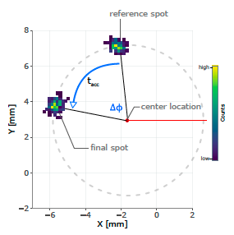
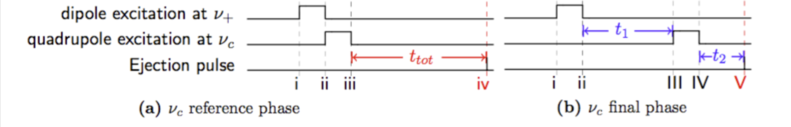

PI-ICR Basics
The cyclotron frequency (⍵_{c}) is determined via the phase difference (ɸ_{c}) between two spots with different accumulation times (Tacc)
Reference Spot: Tacc = 0
Final Spot: Tacc = Nonzero Value
PhIAT determines the X/Y Positions of these spots to find each of their phases

Slide 4
BEFORE YOU CONTINUE! -- titan_data
PhIAT.m uses midas_to_phiat.py, which requires you download the titan_data package
This can be downloaded here: https://bitbucket.org/ttriumfdaq/titan_data/src/master/
On Line 20 in midas_to_phiat.py: Change the address in sys.path.append from '/Users/wsporter/Documents/Physics_Research/TITAN/PIICR_Analysis/titan_data' to the local address of titan_data on your computer (i.e. '/local/address/to/titan_data’)

Slide 5
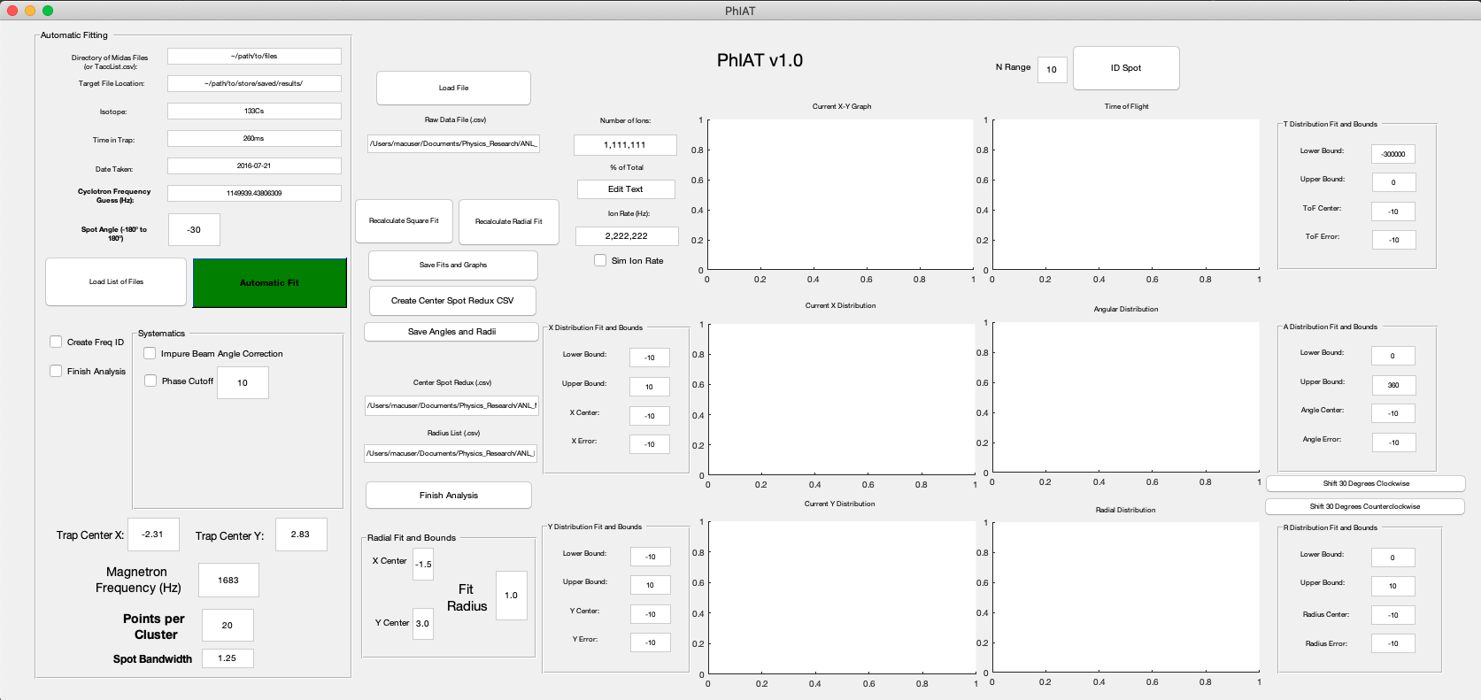
Getting Started
Press the Run Button to bring up the PhIAT GUI:

Slide 6
Automatic fitting will only require the use of items in the red boxes, the rest is used for manual fitting (see Manual Fitting Documentation)

Slide 7
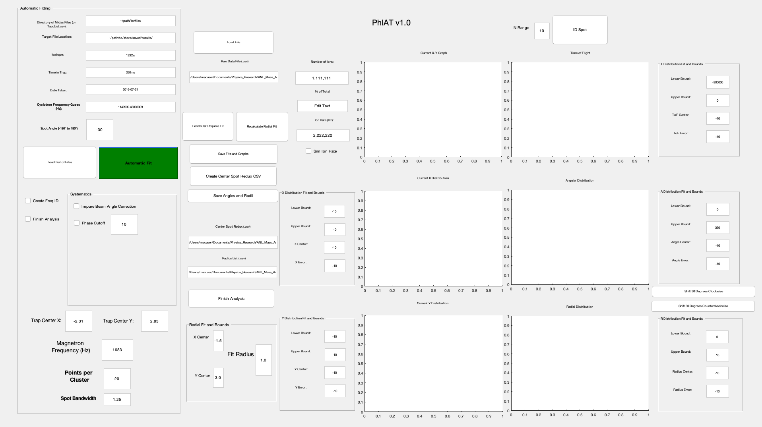
Loading a List of Files
To start, input the address of the directory of MIDAS files (i.e. /Users/wsporter/Documents/Physics_Research/TITAN/PIICR_Analysis/Testing/Test_CAENOffset)
If you have already converted a directory of MIDAS files using midas_to_phiat.py, you can also input the address of the FileList.csv (see midas_to_phiat.py documentation)
Click the Load List of Files button...

Slide 8
Loading a List of Files cont.
Clicking Load List of Files runs midas_to_phiat.py and converts each MIDAS file into a readable .csv file containing (for each event):
X/Y Positions
Times of Flight from Ejection to MCP Contact
What trigger number of the TDC each event was recorded during
midas_to_phiat.py also creates a FileList.csv, which contains a list of addresses of all data files

Slide 9
Loading a List of Files cont.
The FileList.csv is used so PhIAT can navigate to each individual file and then load in that respective data

Slide 10
Automatic Fitting Overview
After pressing the Load List of Files button, every other function (depending on what boxes are checked below) is completed simply by pressing the Automatic Fit button

Slide 11
BEFORE YOU CONTINUE -- Simulated Data
If you are fitting any simulated data (i.e. data produced from PI_ICR_simulated_data.m), make sure the Sim Ion Rate checkbox is checked
Since there is no count timing information from simulated data, leaving this unchecked will cause an error otherwise...

Slide 12
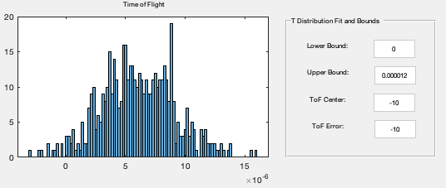
Before Automatic Fitting -- ToF Cuts
Before automatic fitting, it’s advised to apply a time of flight cut to throw away data outside of the expected times of flight (i.e. column 3 of each data .csv)
Press Load File to load just the first file
Using the distribution seen in the ToF plot, determine bounds that cut out data outside of the counts majority
It’s expected the distribution is pseudo-Gaussian
Put these bounds in the Lower Bound and Upper Bound boxes next to the ToF plot
These will be taken into account when Automatic Fit is then pressed

Slide 13
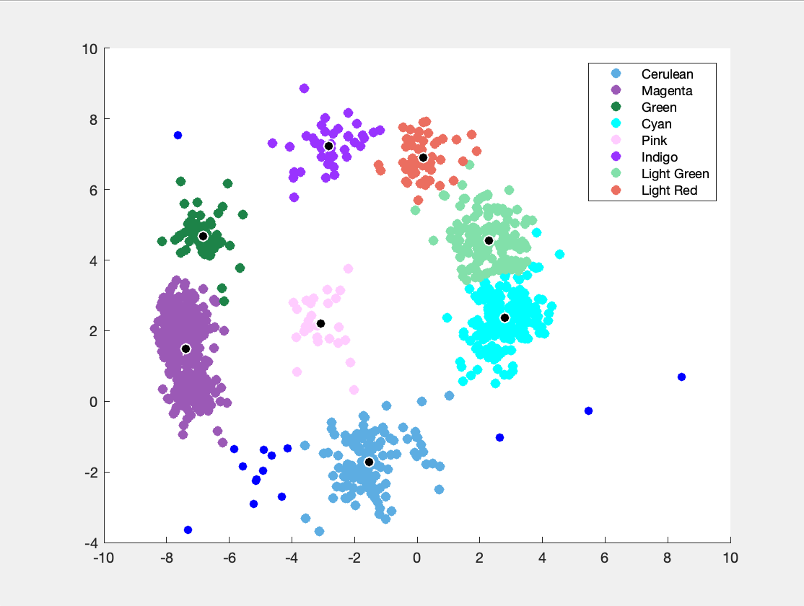
Mean Shift Clustering
Once Automatic Fit is pressed, the X/Y position data of each file is clustered into groups via a Mean Shift algorithm [1]:
Determines what cluster centers would have the highest density of nearest neighbors, and the groups those neighbors into a cluster

Slide 14
Mean Shift Clustering cont.
The total number of cluster is NOT predetermined, depends on two user choices:
Spot Bandwidth: The effective “radius” of the cluster
A smaller value means smaller/finer clusters
Points per Cluster: Any resulting clusters that have less points that this value will instead belong to no cluster
You will likely need to play around with these parameters to get clusters that represent what you would like/expect

Slide 15
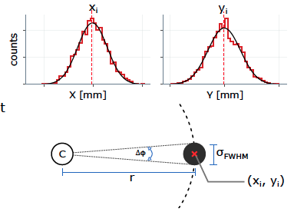
Fitting Clustered Data
The center of each cluster is determined by a 1D Gaussian fit in X/Y
via the Maximum Likelihood method
The resulting fit parameters (mean and square root of the variance) are taken as the spot’s center and standard deviation

Slide 16
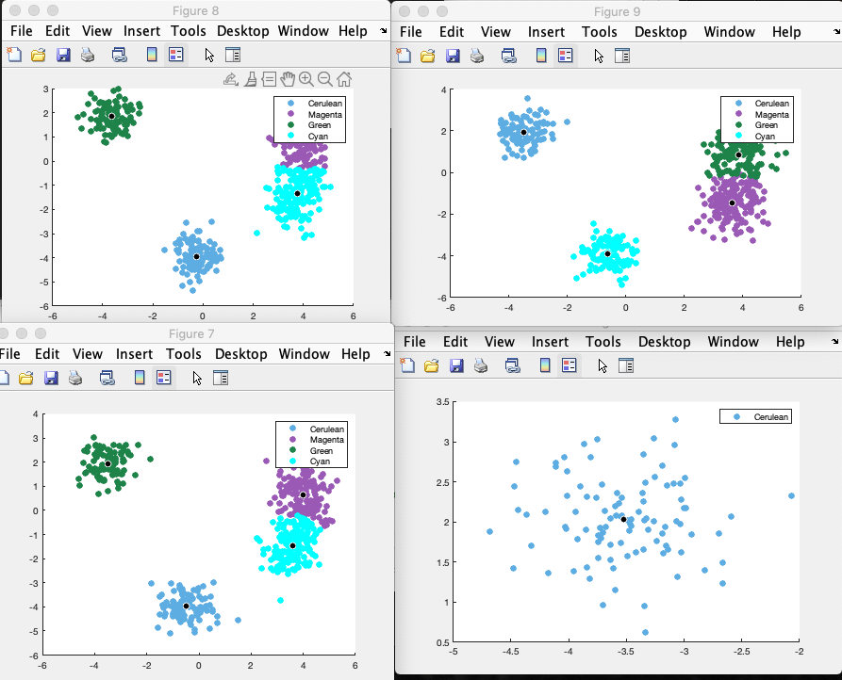
Fitting Clustered Data cont.
Clustered Data (i.e. spot)
Fitted Spot Center
Fits are done for every cluster in a file, and then resulting clusters (and unclustered points) and fit centers are plotted
PhIAT then cycles to the next file and does the same until all files have been fit
If you have not checked any other boxes in the Automatic Fitting section, this is where the process stops

Slide 17
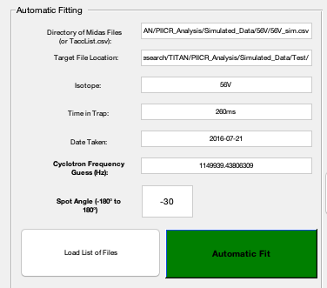
BEFORE YOU CONTINUE -- File Naming
Checking other boxes in the Automatic Fitting section will resulting in files being saved and, thus, will need you to specify a file location (and some other parameters used in naming files):
Target File Location: Folder in which resulting files will be saved (i.e. /Users/wsporter/Documents/Physics_Research/TITAN/PIICR_Analysis/Simulated_Data/Test/)

Slide 18
BEFORE YOU CONTINUE -- File Naming cont.
Isotope: Primary mass of interest being analyzed
Time in Trap: Total time ions spent inside the Penning trap
Date Taken: Date file was taken
These parameters are simply used in naming conventions, so their accuracy is only for user-benefit and has no effect on the analysis itself

Slide 19
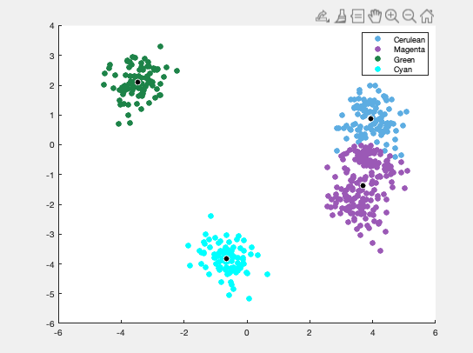
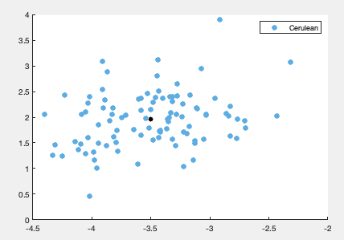

Reference and Final Spots -- How It Works
Each “final” file (Nonzero Tacc) has been paired with a “reference” file (Zero Tacc) in the FileList.csv
Based on ordering in FileList.csv, “final” files were fit first, and “reference” files second
This pairing is used when determining the phase difference (ɸ_{c})
“Final” File: multiple spots
“Reference” File: one spot

Slide 20
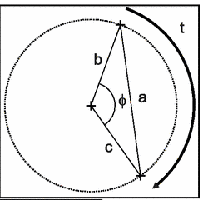
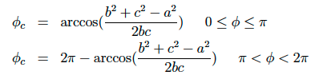
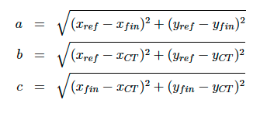
Determining Phase -- How It Works
b: Distance from Trap Center to Reference Spot
c: Distance from Trap Center to Final Spot
a: Distance from Reference Spot to Final Spot

Slide 21

Determining Phase -- Trap Center
The Trap Center [mm] is a user-defined input; make sure it reflects the most recent trap center determination to a given set of data
The Trap Center uncertainty [mm] must be changed in the script itself (lines 556-557)
NOTE: If using simulated data from PI_ICR_simulated_data.m, Trap Center is (0,0)

Slide 22
Finding Number of Turns -- How It Works
To determine ⍵_{c} , we still need to know the number of turns (i.e. full revolutions) the ion made in the trap
N(tacc)
We can’t determine this experimentally, so we need to infer it
This is done using the guess cyclotron frequency (⍵_{c, guess})

Slide 23

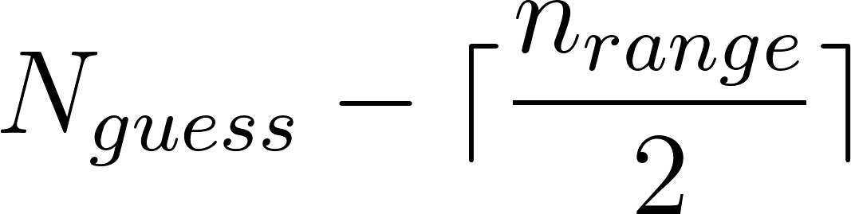
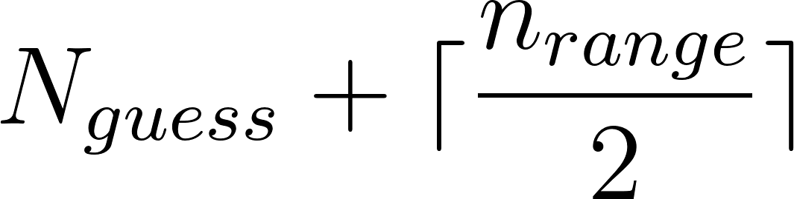
Finding Number of Turns -- How It Works
We determine the number of turns (N_{guess}) a spot would have given ⍵_{c, guess} and ɸ_{c} = 0
We then generate a range of N values, where n_range is user-specified
We then generate a cyclotron frequency (⍵_{c,N}) for every N value
to

Slide 24
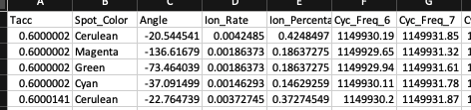
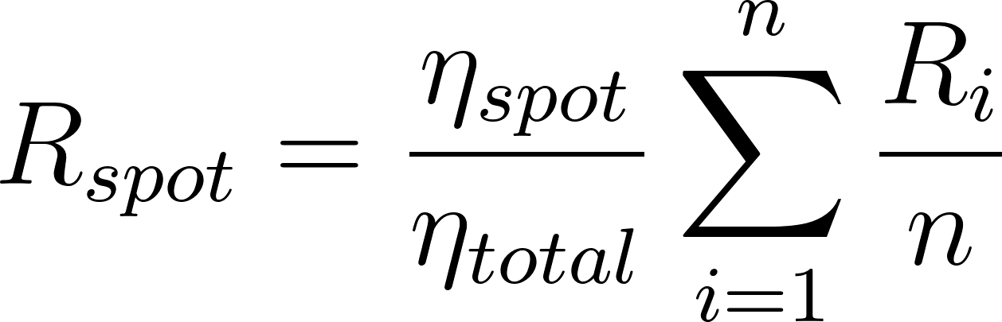
Create Freq ID Overview
Checking Create Freq ID will create ID_Frequencies.csv, which contains the following data about every spot in every ‘final’ file:
Tacc [s]
Spot Color
Spot Angle [-180 to 180 deg] (w.r.t x-axis)
Ion Rate [counts/s]: Rate at which counts in a spot come in
Ion Percentage: Percentage of total counts (unnormalized)
Cyc Freq: Cyclotron frequencies ⍵_{c,N}
R_{i} = Rates from 3rd Column of ion_rate.csv
η_{spot} = Number of counts in spot
η_{total} = Total number of counts in file

Slide 25
Finish Analysis Overview
Checking Finish Analysis will determine the final cyclotron frequency of one of the species present in the file by fitting a sinusoid to a spot’s cyclotron frequency at each Tacc
Outputs:
SineFit.png: An image of the ⍵_{c} vs. Tacc sinusoid fit
RadiusSineFit.png: An image of the Radius vs. Tacc sinusoid fit
Data.xlsx: Contains all relevant fitting information

Slide 26
Choosing a Spot/Species -- How It Works
Select which species you’d like to finish analysis for by designating that spot’s angle in Spot Angle [deg]
From -180 to 180 (w.r.t x-axis)
For a set of files you want to ‘finish analysis’ on, all spots for a given species should be at a similar angle
This reasoning is discussed more in WHERE

Slide 27
Selecting ⍵_{c} from ⍵_{c,N} -- How It Works
We need to select one ⍵_{c} from the array of ⍵_{c,N} for each spot
The ⍵_{c} closest to ⍵_{c, guess} is selected, and thus is dependent on the user-input for Cyclotron Frequency Guess

Slide 28
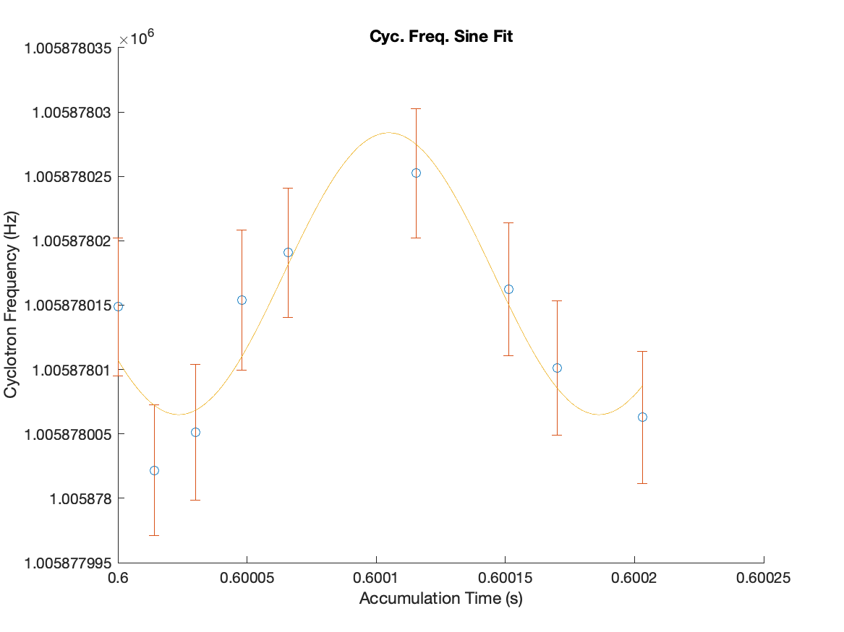
Sinusoid Fitting -- How It Works
We now have a cyclotron frequency for our species at each Tacc
We fit a 3-parameter sinusoid to ⍵_{c} , where b₀ is our true cyclotron frequency
b₁ and b₃ are also fit, whereas b₂ is fixed at the magnetron frequency (⍵₋)
⍵₋ is characteristic to the trap; make sure the user-input reflect the measurement most recent to the data

Slide 29
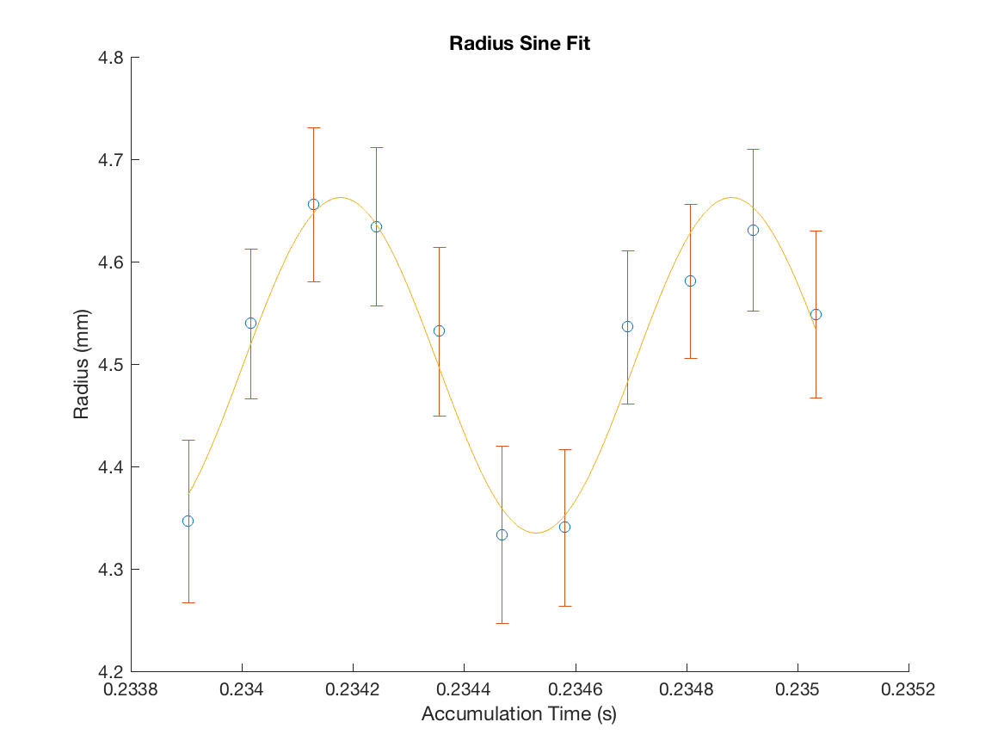
Radius Sinusoid Fitting -- How It Works
The radii of the spots should also follow a similar sinusoid
A 4-parameter sinusoid is fit to the radius data
This is only used to confirm the data is as expected
If the fit is poor, this can be a signal that something is wrong
A .png image of both the w_c and Radius sinusoid fits is saved (SineFit.png and RadiusSineFit.png)

Slide 30
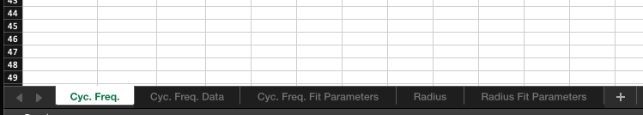
Data.csv
Data.csv is saved, containing five tabs of relevant data:
Cyc. Freq. : The final cyclotron frequency, uncertainty and reduced Chi^2
Cyc. Freq. Data : The data input to sinusoid cyclotron frequency fit
Cyc. Freq. Fit Parameters: Resulting sinusoid fit parameters and uncertainties
Radius: The final radius, uncertainty and reduced Chi^2
Radius Fit Parameters: Resulting radius sinusoid fit parameters and uncertainties

Slide 31
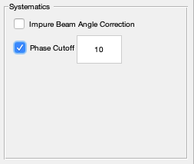
Systematics -- Phase Cutoff
To minimize effects of magnetic field misalignment, a phase cutoff can be applied to cut away any data points with a reference/final phase difference greater than a user-set value (in deg)
i.e. any data points with final/reference phase > 10 deg here are not incorporated into sinusoid fit
Only implemented when box is checked

Slide 32

Systematics -- Impure Beam Correction
The presence of multiple species in a beam will shift the reference phase, as ions acquire a small amount of mass-dependent phase during the ⍵₊ excitation
This is corrected for by:
𝜒_{i}: fractional percentage of the ith contaminant species
⍵^{i}_{c}: cyclotron frequency of ith contaminant species
ɸ_{corr}: phase correction for species of interest
⍵_{c}: cyclotron frequency of species of interest

Slide 33

Systematics -- Impure Beam Correction
ν_{+/c}: frequency of ⍵_{+/c} excitation pulses
T_{+/c}: periods of ⍵_{+/c} excitation pulses
𝜒_{i}: fractional percentage of the ith contaminant species
⍵^{i}_{c}: cyclotron frequency of ith contaminant species
ɸ_{corr}: phase correction for species of interest
⍵_{c}: cyclotron frequency of species of interest

Slide 34
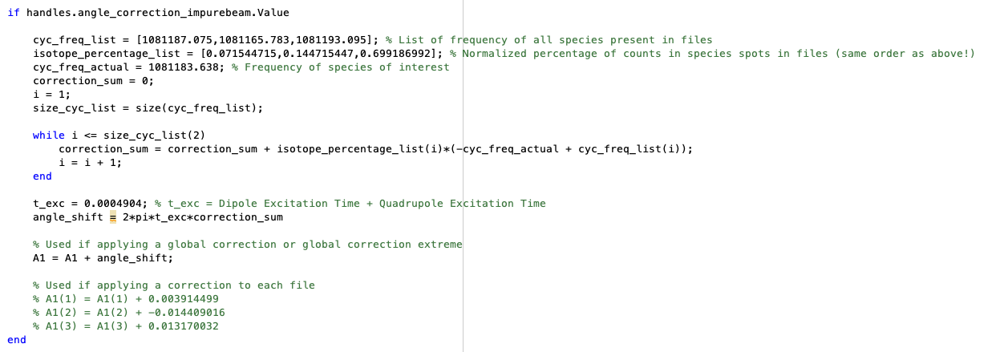
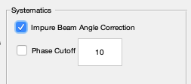
Systematics -- Impure Beam Correction
As of now, not automatically implemented, requires editing of code
Only cyc_freq_list (⍵^{i}_{c}), isotope_percentage_list (𝜒_{i}), cyc_freq_actual (⍵_{c}) and t_exc (t_{ex}) will be changed
Only implemented when box is checked

Slide 35
Systematics -- Impure Beam Correction
If this is used, percentages and frequencies are global (i.e. average over all files)
If this is used, percentages and frequencies are for each individual file and manually applied in order of FileList

Slide 36
Standard Analysis Procedure
1). Fit shorter Tacc files to determine potential cyclotron frequencies of unknown species
2). Once species identified, use higher Tacc files to find proper cyclotron frequency of species/ions of interest
3). Find cyclotron frequency of calibrant ion (separately taken data)
4). Determine mass excess from interest/calibrant ion frequencies using freq_to_mass_converter.m

Slide 37
Analysis Procedure Step 1
Determine possible cyclotron frequencies of all spots in files with (relatively) shorter Tacc
These Tacc are typically chosen arbitrarily, such that a certain species will NOT always end up at the same phase
This is critical, as it would be impossible to identify species via cyclotron frequencies if their spots were at the same phase across a set of files
This is done via Create Freq ID and identifying common frequencies across files
NOTE: Here, use frequencies derived from AME as guess frequencies based on what is expected in the beam (TITAN-spreadsheet.xlsx will be helpful, see end for more details)

Slide 38
Analysis Procedure Step 2
Higher Tacc files are used to find the final cyclotron frequency (using sinusoid fitting)
These files will have Taccs chosen s.t. the ion of interest should be at similar angles close to the reference spot angle FOR ALL FILES
The guess frequency here will be the frequency of the ion of interest species as determined in step 1
The results of the sinusoid fit constitute the “final” cyclotron frequency for the ion of interest

Slide 39
Analysis Procedure Step 3
The cyclotron frequency of a calibrant ion is determined using the same prescription as step 2
Since calibrants are precisely known, the guess frequency can be derived from AME as in step 1

Slide 40
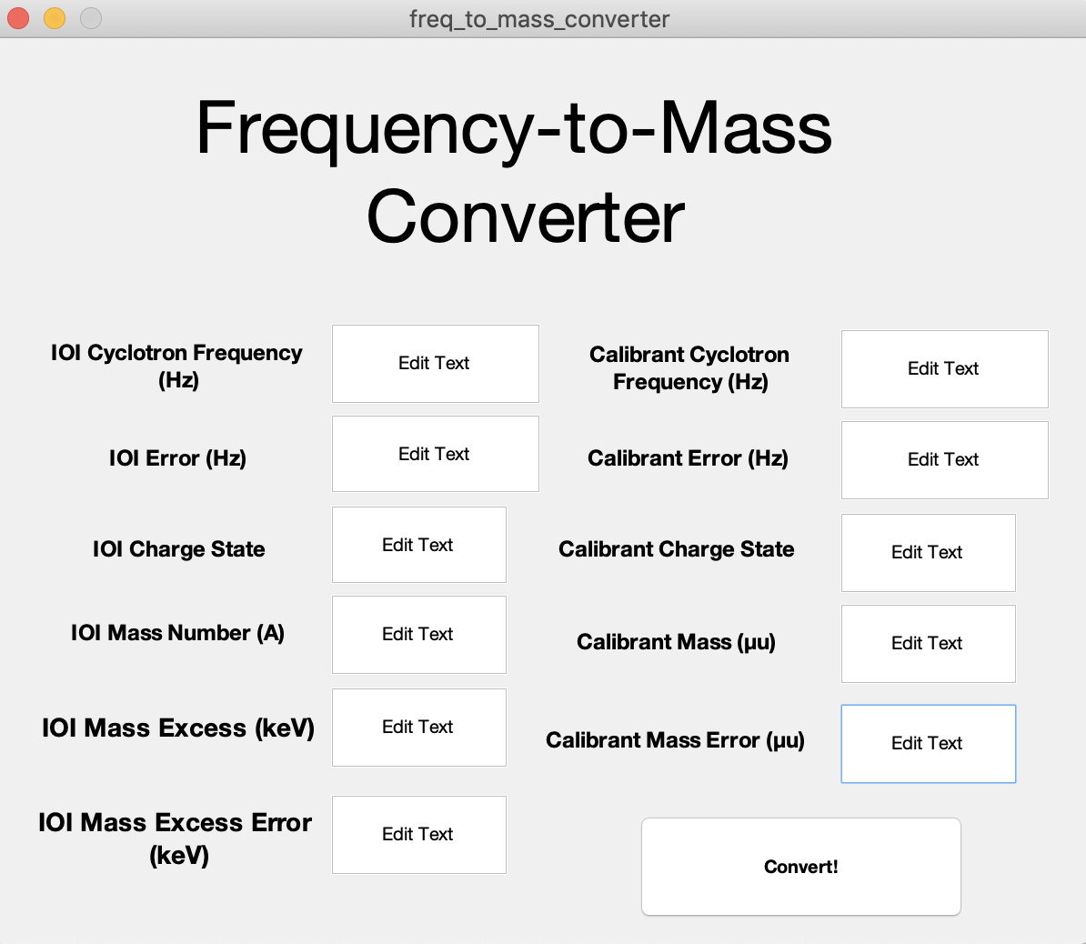
Analysis Procedure Step 4 - freq_to_mass_converter.m
A separate GUI, freq_to_mass_converter, can be used to find the mass excess of the ion of interest from the frequencies of the ion of interest and calibrant

Slide 41
freq_to_mass_converter.m
Blocks in red are user-input
The output mass excess and error appear in the two boxes in blue when Convert! is pressed
And there you go! We now have a final mass excess and error and have (in principle) completed the analysis process

Slide 42
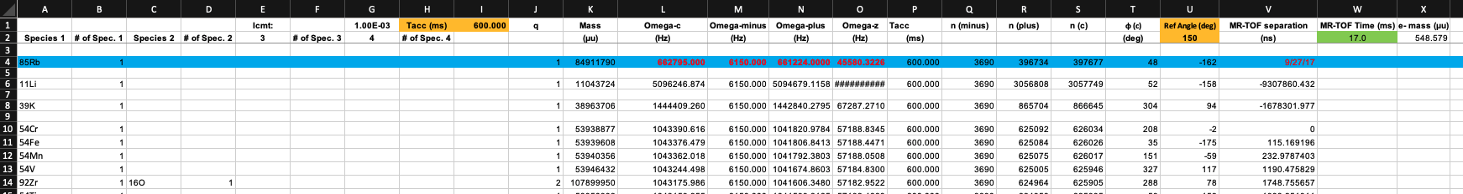
TITAN_spreadsheet.xlsx
A helpful, editable spreadsheet is included in the PhIAT package that includes masses, frequencies, phases, etc. -- TITAN_spreadsheet-YYYY.xlsx

Slide 43
TITAN_spreadsheet.xlsx -- Things that can be changed...
Tacc (ms): Changing this changes the phases in columns T/U based on the corresponding frequency
Ref Angle (deg): Set this as whatever angle the reference spot appears at for a given Tacc...this will shift all angles in column U appropriately given that reference spot

Slide 44
TITAN_spreadsheet.xlsx -- Things that can be changed...
Masses: Masses can be automatically input by putting an isotope in the Species 1 column (formatted AEl) and then designating the number of those isotopes in # of Spec. 1
Molecules are input by adding on appropriate isotopes and numbers in following columns
This automatically inputs the atomic mass in Column K

Slide 45
Please contact Sam Porter (wporter@triumf.ca) if you have any questions
Happy PI-ICRing!

Slide 46
References
[1]: D. Comaniciu and P. Meer, "Mean shift: a robust approach toward feature space analysis," in IEEE Transactions on Pattern Analysis and Machine Intelligence, vol. 24, no. 5, pp. 603-619, May 2002, doi: 10.1109/34.1000236.

